Slide 1

Chapter 8 Reasoning Under Uncertainty –Part II
Main Textbook: Artificial Intelligence Foundations of Computational Agents, 2nd Edition, David L. Poole and Alan K Mackworth, Cambridge University Press, 2018.
Reference Textbook: Artificial Intelligence: A Guide to Intelligence Systems, Michael Negnevitsky, 3rd Edition, 2011, Addison Wesley, ISBN 978-1408225745

Slide 2
Probabilistic Inference
The most common probabilistic inference task is to compute the posterior distribution of a query variable or variables given some evidence.
The main approaches for probabilistic inference in belief networks are
Exact inference:
where the probabilities are computed exactly.
A simple way is to enumerate the worlds consistent with the evidence.
The variable elimination (VE) algorithm is an Exact Inference algorithm that uses dynamic programming and exploits conditional independence.

Slide 3
Probabilistic Inference
Approximate inference:
where probabilities are only approximated and:
They produce guaranteed bounds on the probabilities.
They produce probabilistic bounds on the error produced. Such algorithms might guarantee that the error, for example, is within 0.1 of the correct answer 95% of the time.
Variational inference:
To find an approximation to the problem that is easy to compute
First, choose a class of representations that are easy to compute.
This class could be a set of disconnected belief networks (with no arcs)
Next, try to find a member of the class that is closest to the original problem.
Thus, the problem reduces to an optimization problem of minimizing the error, followed by a simple inference problem.

Slide 4
Variable Elimination for Belief Networks
As for finding solutions to CSPs, the variable elimination (VE) algorithm can be adapted to find the posterior distribution for a variable in a belief network with conjunctive evidence.
The VE algorithm is based on the notion that a belief network specifies a factorization of the joint probability distribution
Recall that P(X|Y) is a function from variables (or sets of variables) X and Y into the real numbers that, given a value for X and a value for Y, return the conditional probability of the value for X, given the value for Y.
The VE algorithm for belief networks manipulates factors to compute posterior probabilities.
A factor is a function from a set of random variables into a number.

Slide 5
Conditional Probability Tables
A conditional probability, P(Y| X₁, . . . , X_{k}), is a function from the variables Y, X₁, . . . , X_{k} into non-negative numbers that satisfy the constraints that for each assignment of values to all of X₁, . . . , X_{k} the values for Y sum to 1.
That is, given values to all of the variables, the function returns a number that satisfies the constraint:
With a finite set of variables with finite domains, conditional probabilities can be implemented as arrays.
There is a unique representation of each factor as a one-dimensional array indexed by natural numbers. This representation of a conditional probability is called a conditional probability table (CPT).

Slide 6
Conditional Probability Tables
The following two methods are used to specify store probabilities:
Store un-normalized probabilities, which are non-negative numbers proportional to the probability.
The probability can be computed by normalizing:
dividing each value by the sum of the values, summing over all values for the domain of hypothesis Y.
Store the probability for all but one of the values of Y.
In this case, the probability of this other value can be computed to obey the constraint above.
In particular, if Y is binary, we only need to represent the probability for one value, say Y = true or Y = false, which can be computed from this.

Slide 7
Conditional Probability Tables
Example 8.18: Figure 8.6 shows three conditional probabilities tables. On the top left is P(Smoke|Fire), and on the right is P(Alarm|Fire, Tampering), from Example 8.15, which uses Boolean variables.
These tables do not specify the probability of the child being false. This can be computed from the given probabilities, for example,
P(~Alarm|~Fire,Tampering) = 1−0.85 = 0.15
On the bottom is a simple example, with domains {t, f}, which will be used in the following examples.
Given a total ordering of the parents (Figure 8.6), such as Fire is before Tampering in the right table, and a total ordering of the values, such as true is before false, the table can be specified by lexicographic order: [0.5, 0.99, 0.85, 0.0001].

Slide 8
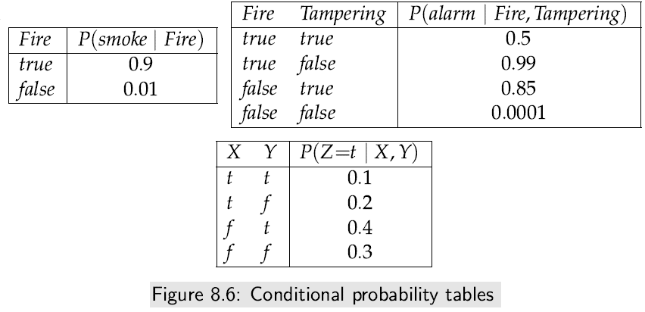
Conditional Probability Tables

Slide 9
Conditional Probability Tables
Factors:
A factor is a function from a set of random variables into a number:
A factor f on variables X₁, . . . ,X_{j} is written as f(X₁, . . , X_{j}).
The variables X₁, . . . , X_{j} are the variables of factor f, and f is a factor on X₁, . . . , X_{j} .
Suppose f (X₁, . . . , X_{j}) is a factor, and each v_{i} is an element of the domain of X_{i}.
f (X₁ = v₁, X₂ = v₂, . . . , X_{j} =v_{j}) is a number that is the value of f when each X_{i} has value v_{i}.
Some of the variables of a factor can be assigned to values to make a new factor on the other variables. This operation is called conditioning on the values of the assigned variables.

Slide 10
Factors
Example 8.19: Figure 8.7 shows a factor r(X, Y, Z) on variables X, Y, and Z as a table. This assumes that each variable is binary with domain {t, f}. This factor could be obtained from the last conditional probability table in Figure 8.6.
Figure 8.7 also gives a table for the factor r(X=t, Y, Z), which is a factor on Y, Z.
Similarly, r(X=t, Y=t, Z=f ) is a factor on Y, and r(X=t, Y=f ,Z=f ) is a number.

Slide 11
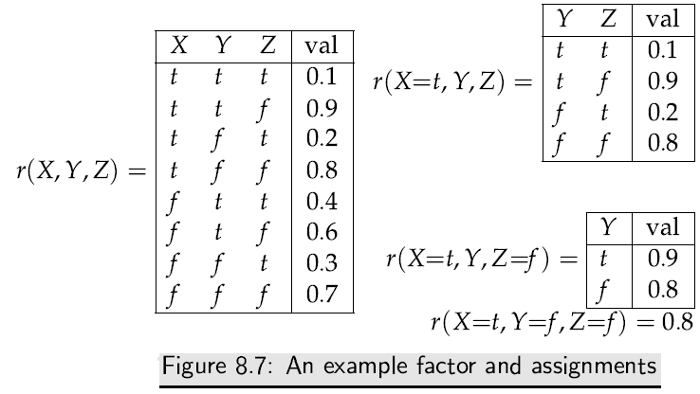
Factors

Slide 12
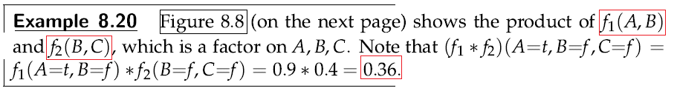
Factors
Factors can be multiplied together. Suppose f₁ and f₂ are factors, where f₁ is a factor that contains variables X₁, . . . ,X_{i} and Y₁, . . . , Y_{j}, and f₂ is a factor with variables Y₁, . . . ,Y_{j} and Z₁, . . . ,Z_{k}, where Y₁, . . . , Y_{j} are the variables in common to f₁ and f₂.
The product of f₁ and f₂, written (f₁ ∗ f₂), is a factor on the union of the variables, namely X₁, . . . , X_{i}, Y₁, . . . ,Y_{j} , Z₁, . . . ,Z_{k}, defined by:
(f₁ ∗ f₂)(X₁, . . . , X_{i}, Y₁, . . . ,Y_{j} , Z₁, . . . ,Z_{k}) =
f₁(X₁, . . . , X_{i}, Y₁, . . . , Y_{j}) ∗ f₂(Y₁, . . . , Y_{j}, Z₁, . . . , Z_{k}).

Slide 13
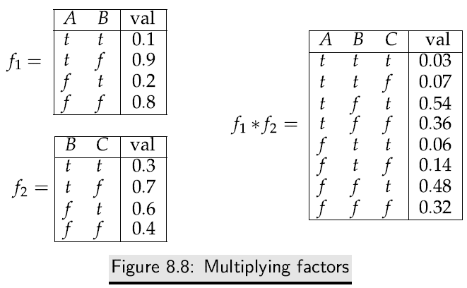
Factors

Slide 14
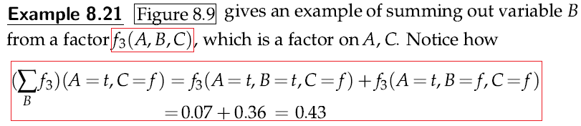
Factors
The remaining operation is to sum out a variable in a factor. Given factor f(X₁, . . . ,X_{j}), summing out a variable, say X₁, results in a factor on the other variables, X₂, . . . , X_{j}, defined by
where {v₁, . . . , v_{k}} is the set of possible values of variable X₁.

Slide 15
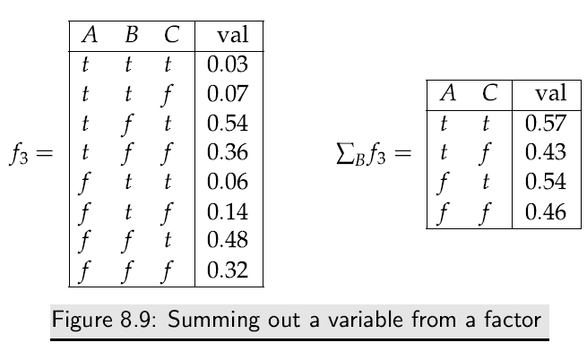
Factors

Slide 16
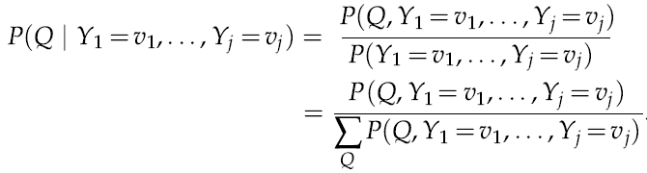
Variable Elimination
Given evidence Y₁ = v₁, . . . , Y_{j} = v_{j}, and query variable Q, the problem of computing the posterior distribution on Q can be reduced to the problem of computing the probability of conjunctions:
The algorithm computes the factor P(Q, Y₁ = v₁, . . . , Y_{j} = v_{j}) and normalizes.
Note that this is a factor only of Q; given a value for Q, it returns a number that is the probability of the conjunction of the evidence and the value for Q.

Slide 17
Variable Elimination
The belief network inference problem is thus reduced to a problem of summing out a set of variables from a product of factors.
The distribution law specifies that a sum of products, such as (xy + xz), can be simplified by distributing its common factor x results in x(y + z).
The resulting form is more efficient to compute.
Distributing out common factors is the essence of the VE algorithm
The elements multiplied together are called “factors” because of the use of the term in algebra.
Initially, the factors represent the conditional probability distributions, but the intermediate factors are just functions of variables created by adding and multiplying factors.

Slide 18
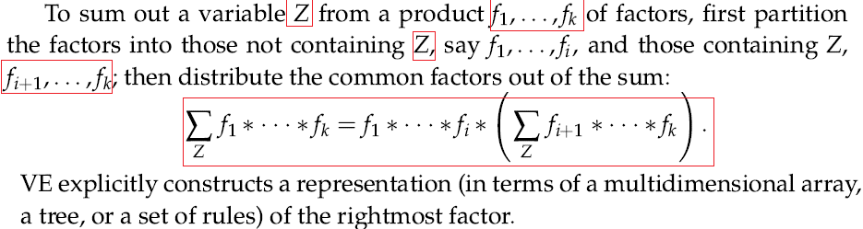
Variable Elimination
To compute the posterior distribution of a query variable given observations:
Construct a factor for each conditional probability distribution.
Eliminate each of the non-query variables:
if the variable is observed, its value is set to the observed value in each of the factors in which the variable appears,
otherwise the variable is summed out.
Multiply the remaining factors and normalize.

Slide 19
Variable Elimination
Figure 8.10 gives pseudocode for the VE algorithm.
The elimination ordering could be given a priori or computed on the fly.
It is worthwhile to select observed variables first in the elimination ordering, because eliminating these simplifies the problem.
This algorithm assumes that the query variable is not observed.
If it is observed to have a particular value, its posterior probability is just 1 for the observed value and 0 for the other values.

Slide 20
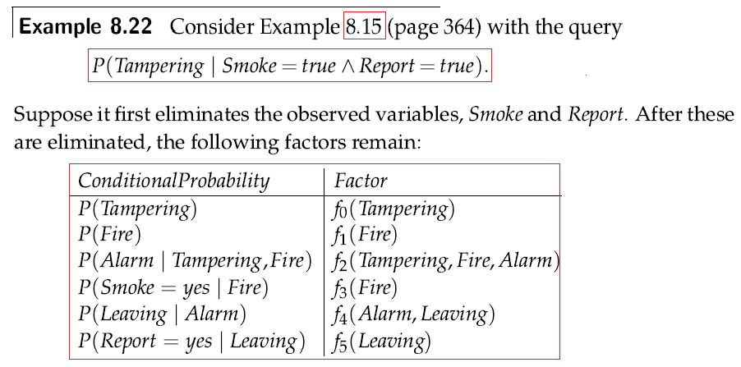
Variable Elimination

Slide 21
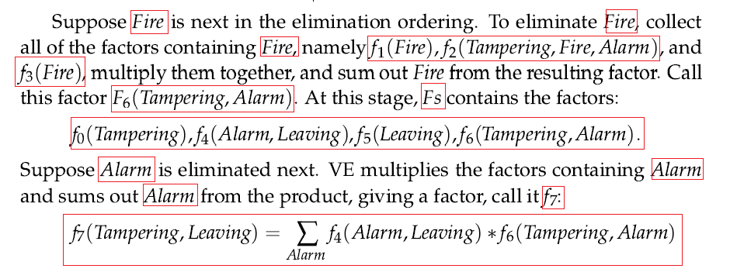
Variable Elimination

Slide 22
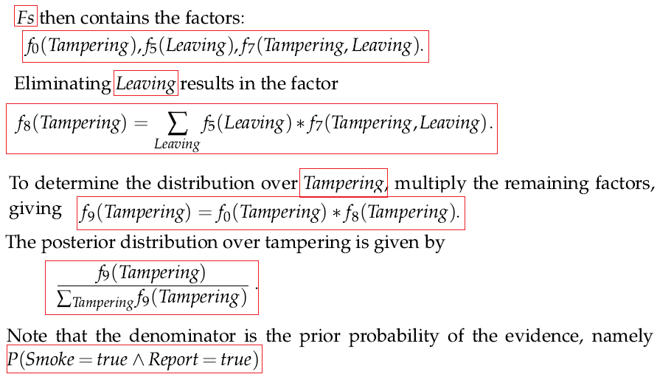

Slide 23
Variable Elimination
Example 8.23:Consider the same network as in the previous example but with the following query: P(Alarm | Fire=true). When Fire is eliminated, the factor P(Fire) becomes a factor of no variables; it is just a number, P(Fire=true). Suppose the Report is eliminated next. It is in one factor, which represents P(Report | Leaving). Summing over all of the values of the Report gives a factor on Leaving, all of whose values are 1. This is because
P(Report=true | Leaving=v) +P(Report=false | Leaving=v) = 1 for any value v of Leaving. If Leaving is eliminated next, a factor of all 1 is multiplied by a factor representing P(Leaving | Alarm), and Leaving is summed out. This, again, results in a factor, all of whose values are 1. Similarly, eliminating Smoke results in a factor of no variables, whose value is 1. Eliminating Smoke would result in a factor of no variables, which would not affect the posterior distribution of the Alarm. Eventually, there is only the factor on the Alarm that represents its prior probability and a constant factor that will cancel in the normalization.

Slide 24
Variable Elimination
To speed up the inference, variables that are irrelevant to answer a query given the observations can be pruned.
In particular, any node that has no observed or queried descendants and is itself not observed or queried may be pruned.
This may result in a smaller network with fewer factors and variables
For example, to compute P(Alarm | Fire=true), the variables Report, Leaving and Smoke may be pruned.
The complexity of the algorithm depends on a measure of complexity of the network.
The size of a tabular representation of a factor is exponential in the number of variables in the factor
The complexity of VE is exponential in the treewidth (The treewidth of a network) and linear in the number of variables. Finding the elimination ordering with minimum treewidth is NP-hard.

Slide 25
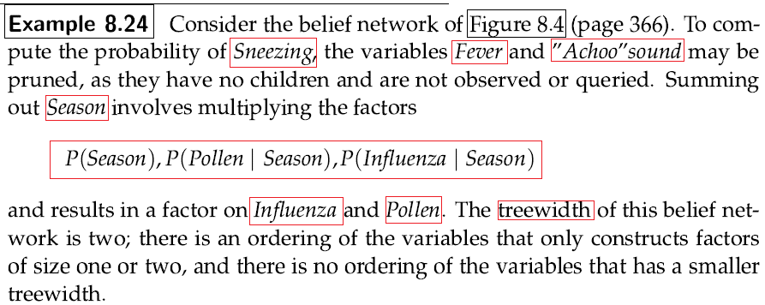
Variable Elimination

Slide 26
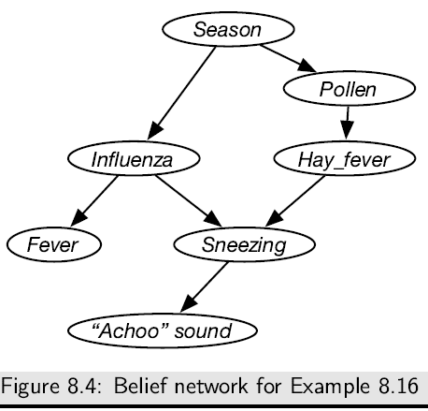
Variable Elimination

Slide 27
Representing Conditional Probabilities and Factors
This section explores some variants for representing factors and conditional probabilities.
A conditional probability distribution is a function on variables; given an assignment to the values of the variables, it gives a number.
A factor is a function of a set of variables; the variables it depends on are the scope of the factor.
Thus a conditional probability is a factor, as it is a function on variables.
Some of the representations are for arbitrary factors and some are specific to conditional probabilities
Factors do not have to be implemented as conditional probability tables.
.

Slide 28
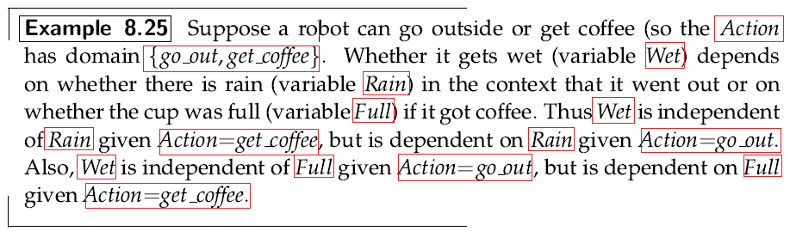
Representing Conditional Probabilities and Factors

Slide 29
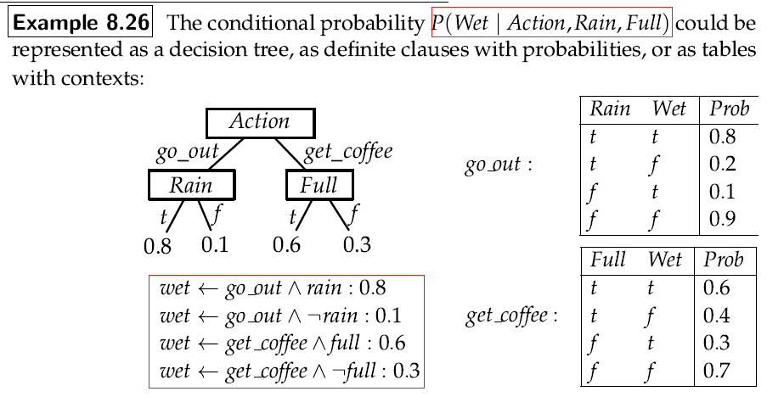
Representing Conditional Probabilities and Factors

Slide 30
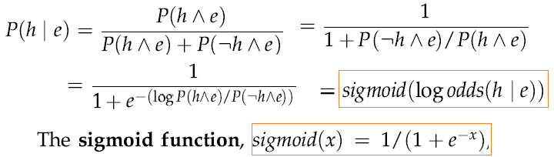
Representing Conditional Probabilities and Factors
Log-linear model of probability: A log-linear model is a model where probabilities are specified as a product of terms. When the terms are non-zero, the log of a product is the sum of logs. To see how such a form is used to represent conditional probabilities, we can write the conditional probability in the following way:

Slide 31
Representing Conditional Probabilities and Factors
The logistic regression model of a conditional probability P(X |Y₁, . . . , Y_{k}) is of the form
where Y_{i} is assumed to have domain {0, 1}. This corresponds to a decomposition of the conditional probability, where the probabilities are a product of terms for each Y_{i}.
Note that P(X |Y₁= 0, . . , Y_{k}= 0) = sigmoid(w₀). Thus w₀ determines the probability when all of the parents are zero.
If Y_{i} is Boolean with values {0, 1}, then P(X |Y₁= 0, . . Y_{i}= 1, . , Y_{k}= 0) = sigmoid(w₀ + w_{i})

Slide 32
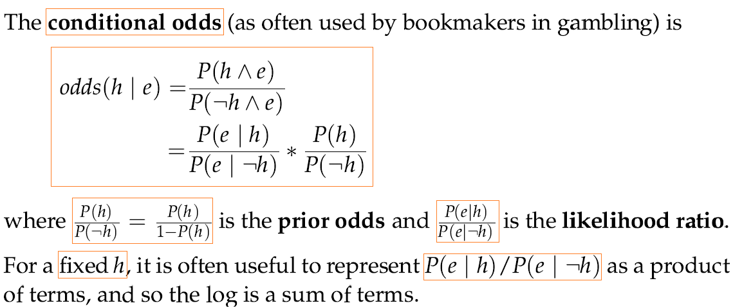
Representing Conditional Probabilities and Factors

Slide 33
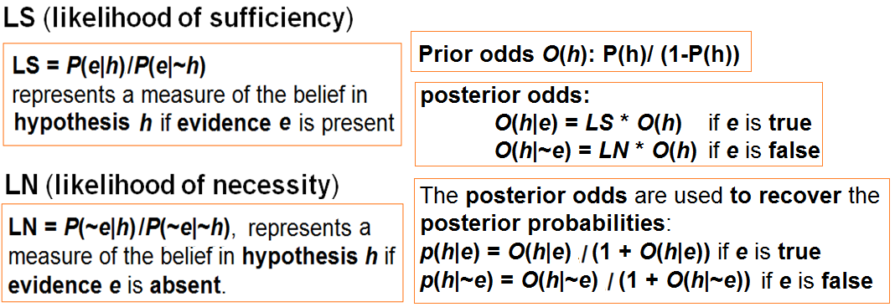
Representing Conditional Probabilities and Factors

Slide 34
Accumulation of Evidence Using Conditional Odds
Developing an agent for a real problem such as the weather forecast:
How the agent predicts it is going to rain tomorrow based on the given conditional probabilities of the two hypotheses (THEN part of the rules) tomorrow is rain and tomorrow is dry from the following two rules:
Rule1: IF today is rain
THEN tomorrow is rain
Rule2: IF today is dry
THEN tomorrow is dry

Slide 35
Accumulation of Evidence Using Conditional Odds
At every time a ‘wet day’ precedes a ‘dry one’ or a ‘dry day’ precedes a ‘wet one’, thus the prior probabilities of 0.5 for both the hypothesis and rewrite the rules as:
Rule1: IF today is rain {LS = 2.5, LN = 0.6}
THEN tomorrow is rain { prior probability is 0.5}
Rule2: IF today is dry {LS = 1.6, LN = 0.4}
THEN tomorrow is dry { prior probability is 0.5}
From the rule1: evidence E = today is rain, ~E = today is dry,
hypothesis H = tomorrow is rain, and ~H = tomorrow is dry
From the rule2: evidence E = today is dry, ~E = today is rain,
hypothesis H = tomorrow is dry, and ~H = tomorrow is rain

Slide 36
Accumulation of Evidence Using Conditional Odds
The value LS (likelihood of sufficiency) represents a measure of the belief in Hypothesis H if evidence E is present, and the LS is given as
LS = p(E|H) ÷ p(E|¬H) (1)
LS = p(today is rain | tomorrow rain) / p(today is rain| tomorrow dry)
Similarly, LN (likelihood of necessity) can be defined as
LN = p(¬E|H) ÷ p(¬E|¬H) (2)
LN = p(today is dry | tomorrow is rain) / p(today is dry | tomorrow dry)
How does the Agent get overall probability of a dry or wet day?
The prior probability of the rule consequent (hypothesis) p(H) is converted into the prior odds O(H):
O(H) = p(H) ÷ (1- p(H)) ; where H is the hypothesis (3)

Slide 37
Accumulation of Evidence Using Conditional Odds
The prior probability is only used when the uncertainty of the consequent (hypothesis) is adjusted for the first time
Then in order to obtain the posterior odds (the prior odds are updated by LS if the antecedent of the rule E is true and by LN if the antecedent is false);
O(H|E) = LS * O(H) ; if E is true (4)
and
O(H|¬E) = LN * O(H) ;if E is false (5)
The posterior odds are then used to recover the posterior probabilities:
p(H|E) = O(H|E) ÷ (1 + O(H|E)) (6)
and
p(H|¬E) = O(H|¬E) ÷ (1 + O(H|¬E)) (7)

Slide 38
Accumulation of Evidence Using Conditional Odds
Suppose the user indicates that today is rain :
Consider Rule1: The prior probability of tomorrow is rain is converted into the prior odds:
O( tomorrow is rain) = O(H) = p(H) / (1- p(H)) = 0.5 / (1 – 0.5) = 1.0 (by Eq. 3)
The evidence today is rain increases the odds by a factor of 2.5 (LS), thereby raising the probability from 0.5 to 0.71 as per following:
O( tomorrow is rain| today is rain) = O(H|E) =LS * O(H) = 2.5 * 1.0 = 2.5 (by Eq. 4)
p( tomorrow is rain| today is rain) = p(H|E) = 2.5 /(1 + 2.5) = 0.71 (by Eq. 6)
Rule2 is also fired based on user indication “today is rain”, the probability of tomorrow is dry is converted into the prior odds:
O( tomorrow is dry) = O(H) = p(H) / (1- p(H)) = 0.5 / (1 – 0.5) = 1.0 (by Eq. 3)
O( tomorrow is dry| today is rain)=O(H|¬E) = LN * O(H) = 0.4 *1.0 = 0.4 (by Eq. 5)
p( tomorrow is dry| today is rain) = p(H|¬E) = 0.4 /1 + 0.4 = 0.29 (by Eq. 7)
Hence if it is raining today there is a 71% chance of it raining and 29% chance of it being dry tomorrow

Slide 39
Accumulation of Evidence Using Conditional Odds
Suppose the user indicates that today is dry:
By a similar calculation there is a 61.5% chance of it being dry and 37.5% chance of it raining tomorrow
Show your calculations.

Slide 40
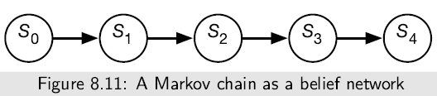
Markov Chains
A Markov chain is a belief network with random variables in a sequence, where each variable only directly depends on its predecessor in the sequence.
Markov chains are used to represent sequences of values, such as the sequence of states in a dynamic system or the sequence of words in a sentence. Each point in the sequence is called stage.
Figure 8.11 shows a generic Markov chain as a belief network.
The network has 5 stages, but does not have to stop at stage 4; it can extend indefinitely.

Slide 41
Markov Chains
The belief network conveys the independence assumption P(S_{i}+1 | S₀, . . . , S_{i}) = P(S_{i}+1 | S_{i}), which is called the Markov assumption.
Often the sequences are in time and, S_{t} represents the state at time t.
Intuitively, S_{t} conveys all of the information about the history that could affect the future states.
The independence assumption of the Markov chain can be seen as “the future is conditionally independent of the past given the present.”
A Markov chain is a stationary model or time-homogenous model if the variables all have the same domain, and the transition probabilities are the same for each stage, i.e., for all i ≥ 0, P(S_{i}+1|S_{i}) = P(S₁|S₀)
To specify a stationary Markov chain, two conditional probabilities are provided:
P(S₀) specifies the initial conditions
P(S_{i}+1|S_{i}) specifies the dynamics, which is the same for each i ≥ 0.

Slide 42
Markov Chains https://brilliant.org/wiki/markov-chains/
Markov chain is a stochastic process, but it differs from a general stochastic process in that a Markov chain must be "memory-less."
That is, (the probability of) future actions are not dependent upon the steps that led up to the present state. This is called the Markov property.
While the theory of Markov chains is important precisely because so many "everyday" processes satisfy the Markov property, there are many common examples of stochastic properties that do not satisfy the Markov property.

Slide 43
Markov Chains https://brilliant.org/wiki/markov-chains/
A common probability question asks what the probability of getting a certain color ball is when selecting uniformly at random from a bag of multi-colored balls.
It could also ask what the probability of the next ball is, and so on.
In such a way, a stochastic process begins to exist with color for the random variable, and it does not satisfy the Markov property.
Depending upon which balls are removed, the probability of getting a certain color ball later may be drastically different.

Slide 44
Markov Chains https://brilliant.org/wiki/markov-chains/

Slide 45
Markov Chains https://brilliant.org/wiki/markov-chains/
A variant of the same question asks once again for ball color, but it allows replacement each time a ball is drawn.
Once again, this creates a stochastic process with color for the random variable.
This process, however, does satisfy the Markov property.

Slide 46
Markov Chains https://brilliant.org/wiki/markov-chains/

Slide 47
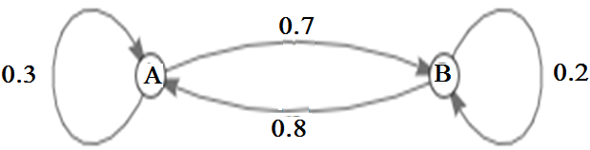
Markov Chains https://brilliant.org/wiki/markov-chains/
In probability theory, the most immediate example is that of a time-homogeneous Markov chain, in which the probability of any state transition is independent of time.
Such a process may be visualized with a labeled directed graph, for which the sum of the labels of any vertex's outgoing edges is 1.

Slide 48
Markov Chains https://brilliant.org/wiki/markov-chains/
To move from A to B, the process must either stay on A the first move, then move to B the second move, or move to B the first move, then stay on B the second move. According to the diagram, that probability is 0.3 x 0.7+ 0.7 x 0.2 = 0.35​.
Alternatively, the probability that the process will be on A after 2 moves is 0.3 x 0.3 + 0.7 x 0.8 = 0.65. Since there are only two states in the chain, the process must be on B if it is not on A, and therefore the probability that the process will be on B after 2 moves is 1 - 0.65 = 0.35.

